Slide 1
New layouts, data types, and architecture for GRNsight v3: a web application for visualizing gene regulatory networks
Mihir Samdarshi
Department of Biology
Loyola Marymount University
March 23, 2019
LMU Undergraduate Research Symposium

Slide 2
Outline
Gene regulatory networks (GRNs) consist of genes, transcription factors, and the regulatory relationships between them.
GRNsight is an open source web application and service for visualizing models of gene regulatory networks.
GRNsight has matured since version 1.0, adding new features such as new layout options and data types.
This has necessitated a complete refactor of GRNsight code to the Model-View-Controller paradigm, which facilitates easier user and developer interactions with the application.

Slide 3
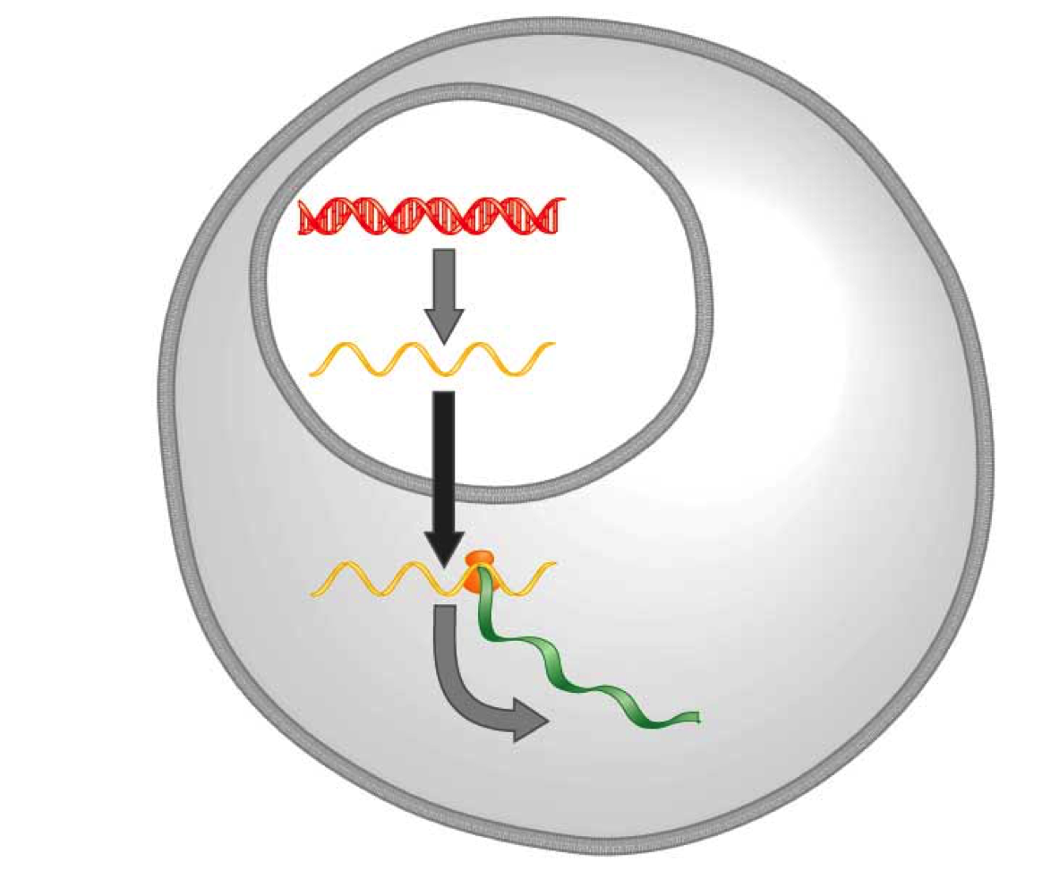
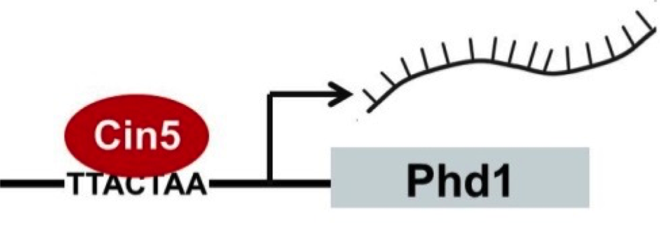
Transcription factors regulate the expression of genes
Transcription factors activate or repress expression of their target genes.
DNA
Transcription
mRNA
Translation
Protein
Gene regulatory process

Slide 4
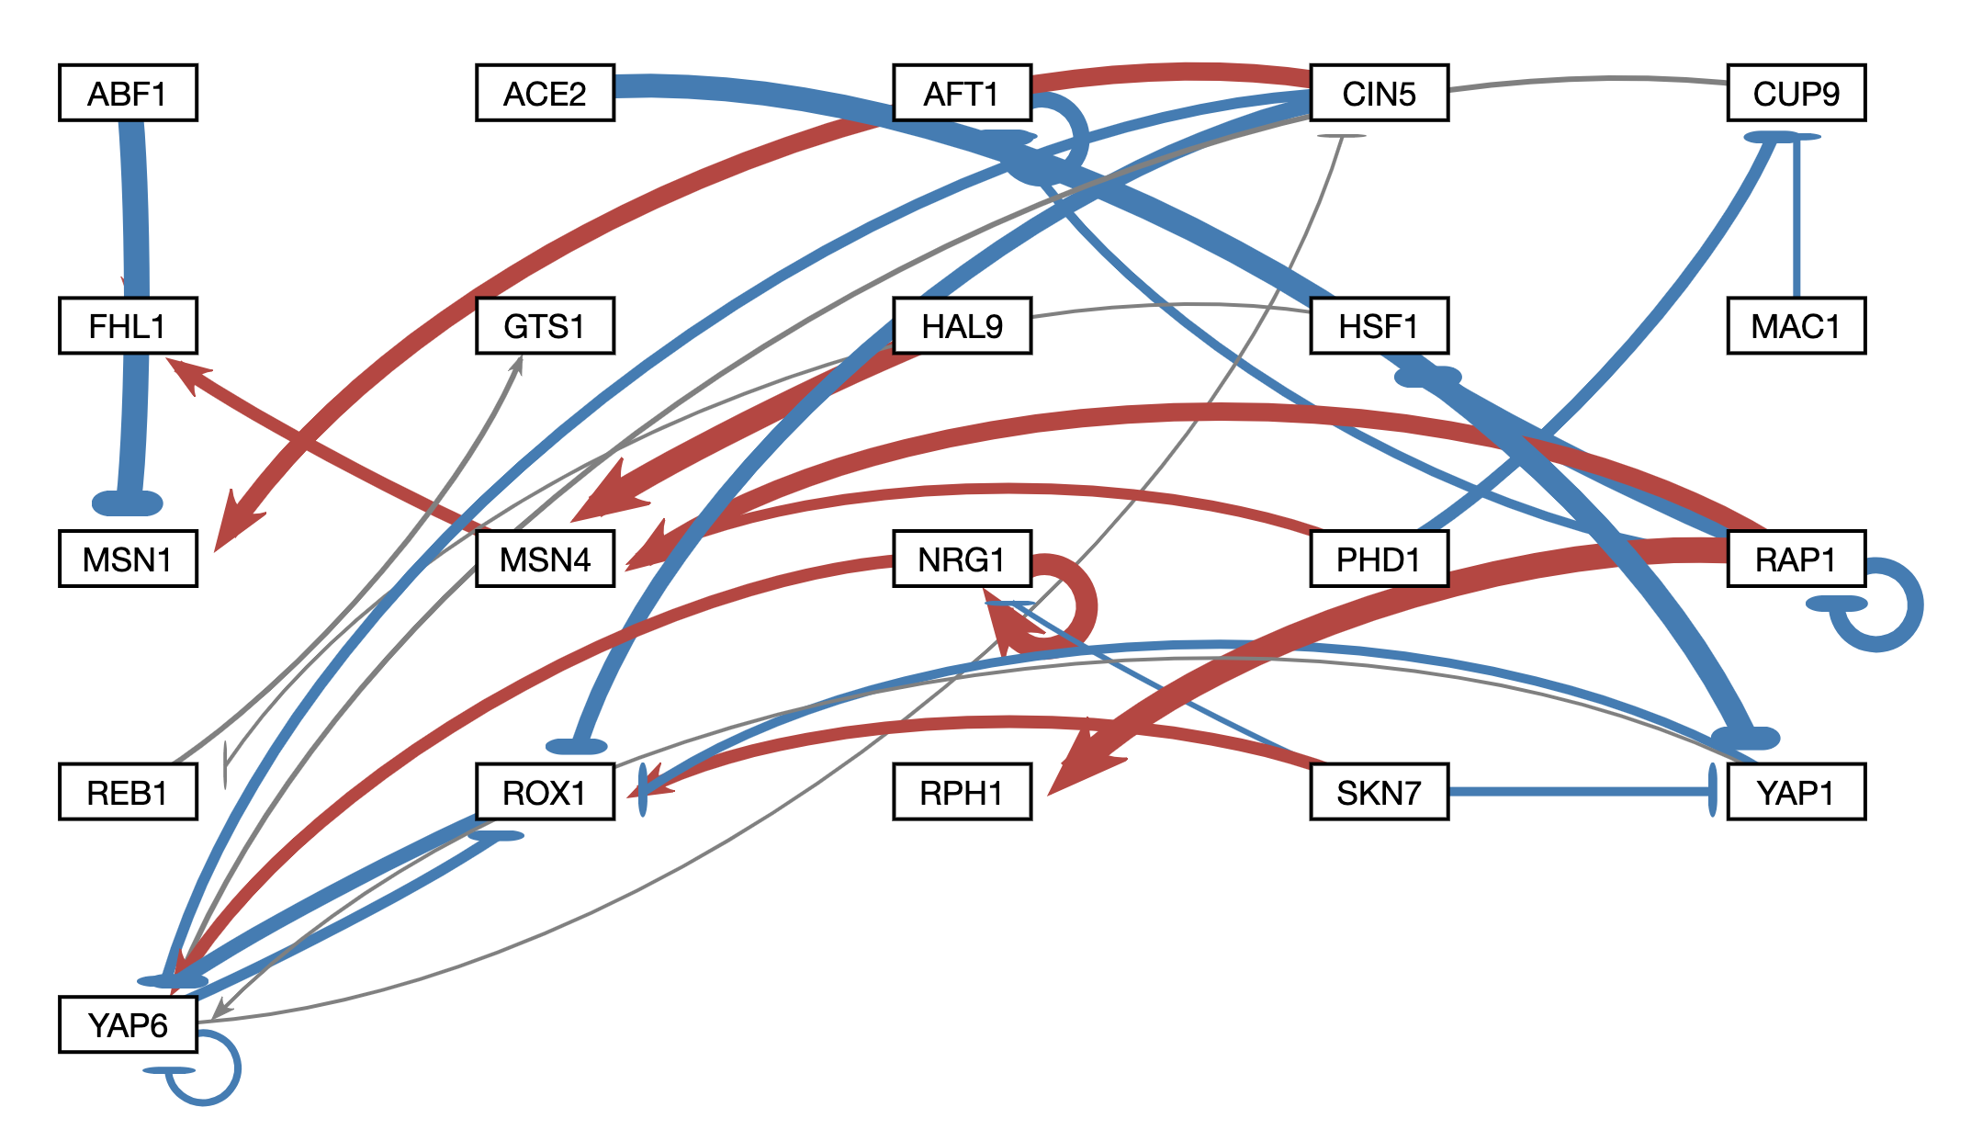
A gene regulatory network (GRN) controls the level of expression of genes and proteins
Schade et al. (2004) Molecular Biology of the Cell 15: 5492.

Slide 5
GRNmap models the dynamics of GRNs to estimate weight parameters (w)
Magnitude of weights represent the influence of transcription factor on its target gene
Positive weights = activation of gene expression
Negative weights = repression of gene expression
Expression patterns of each individual gene are modelled by individual differential equations

Slide 6
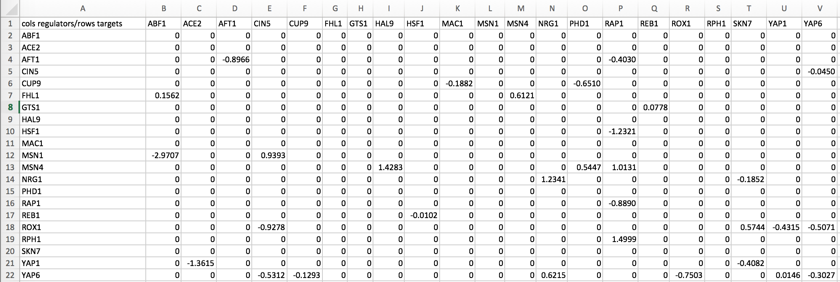
Weight values are outputted from GRNmap as an Excel spreadsheet
.xlsx
21 gene, 31 edge weighted network output from GRNmap

Slide 7
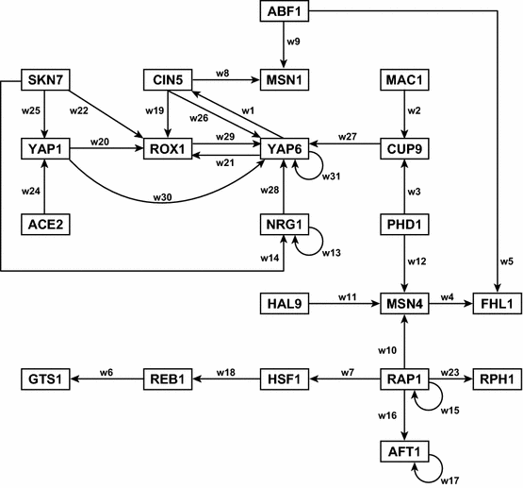
Before GRNsight, graphs would be manually plotted using Adobe Illustrator
Dahlquist et al. (2015) Bulletin of Mathematical Biology 77: 1457.

Slide 8
Cytoscrape and Gephi are examples of software for graph visualizations
Karlari et al. (2013) PLoS One 8: E79398.
Poynter et al. (2015) BMC Cancer 15: 769.

Slide 9
GRNsight fills a niche in bioinformatics visualization software
Cytoscape and Gephi | GRNsight
Optimized for large-scale graphs. | Optimized for small- to medium- scale graphs.
Must be installed. | Exists as a web application.
Several complex features in addition to visualization. | Easy to use, and easily interpretable visualizations.

Slide 10
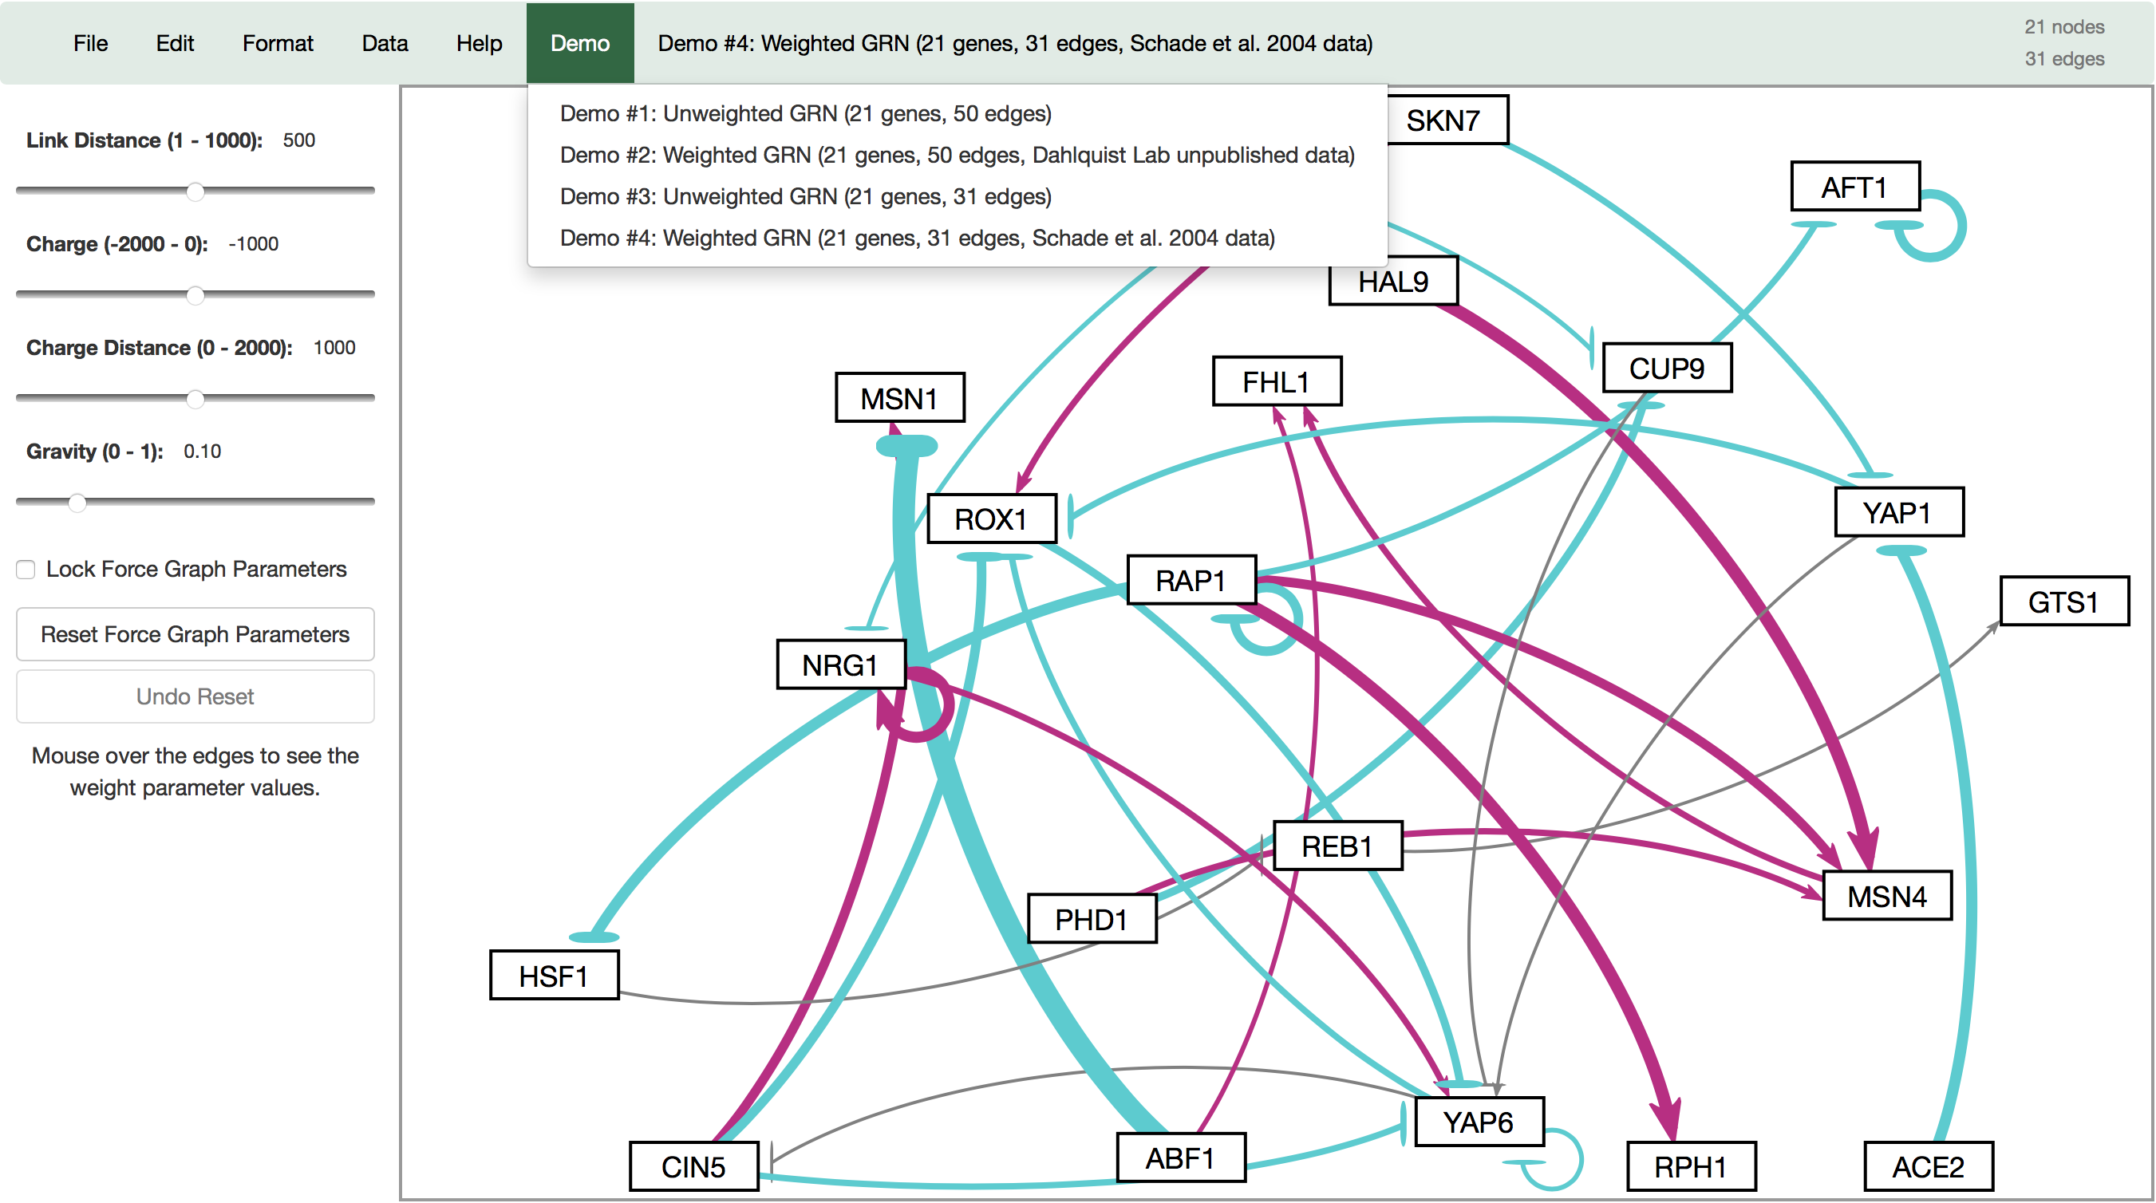
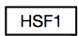
GRNsight automatically produces visualizations of weighted networks from adjacency matrix inputs
Key:
gene
activation
repression
weak influence
Screenshot of GRNsight v1, released Aug 2016

Slide 11
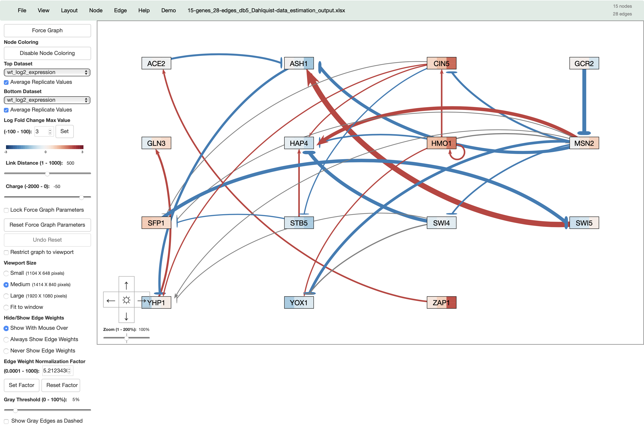


GRNsight has matured to version 3 with many new features added
Key:
gene
activation
repression
weak influence
Screenshot of GRNsight Beta v3.1.12, released February 2019

Slide 12
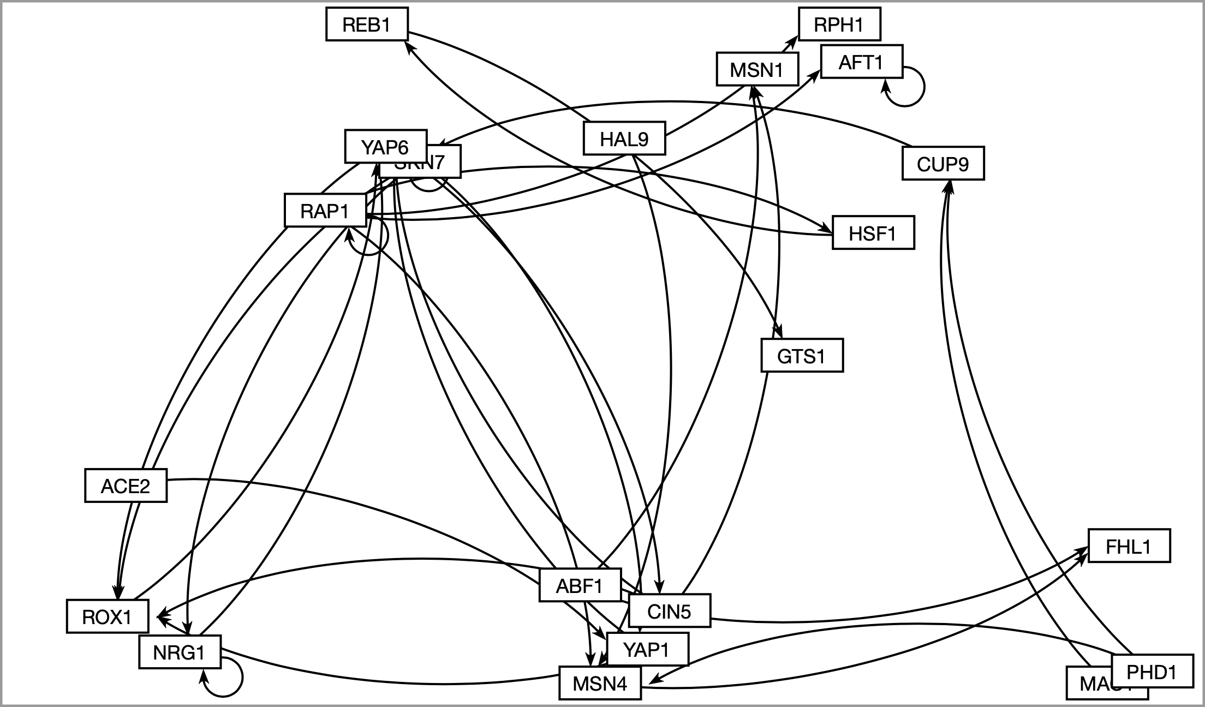
GRNsight now allows users to automatically lay out graphs in an easily readable grid format

Slide 13
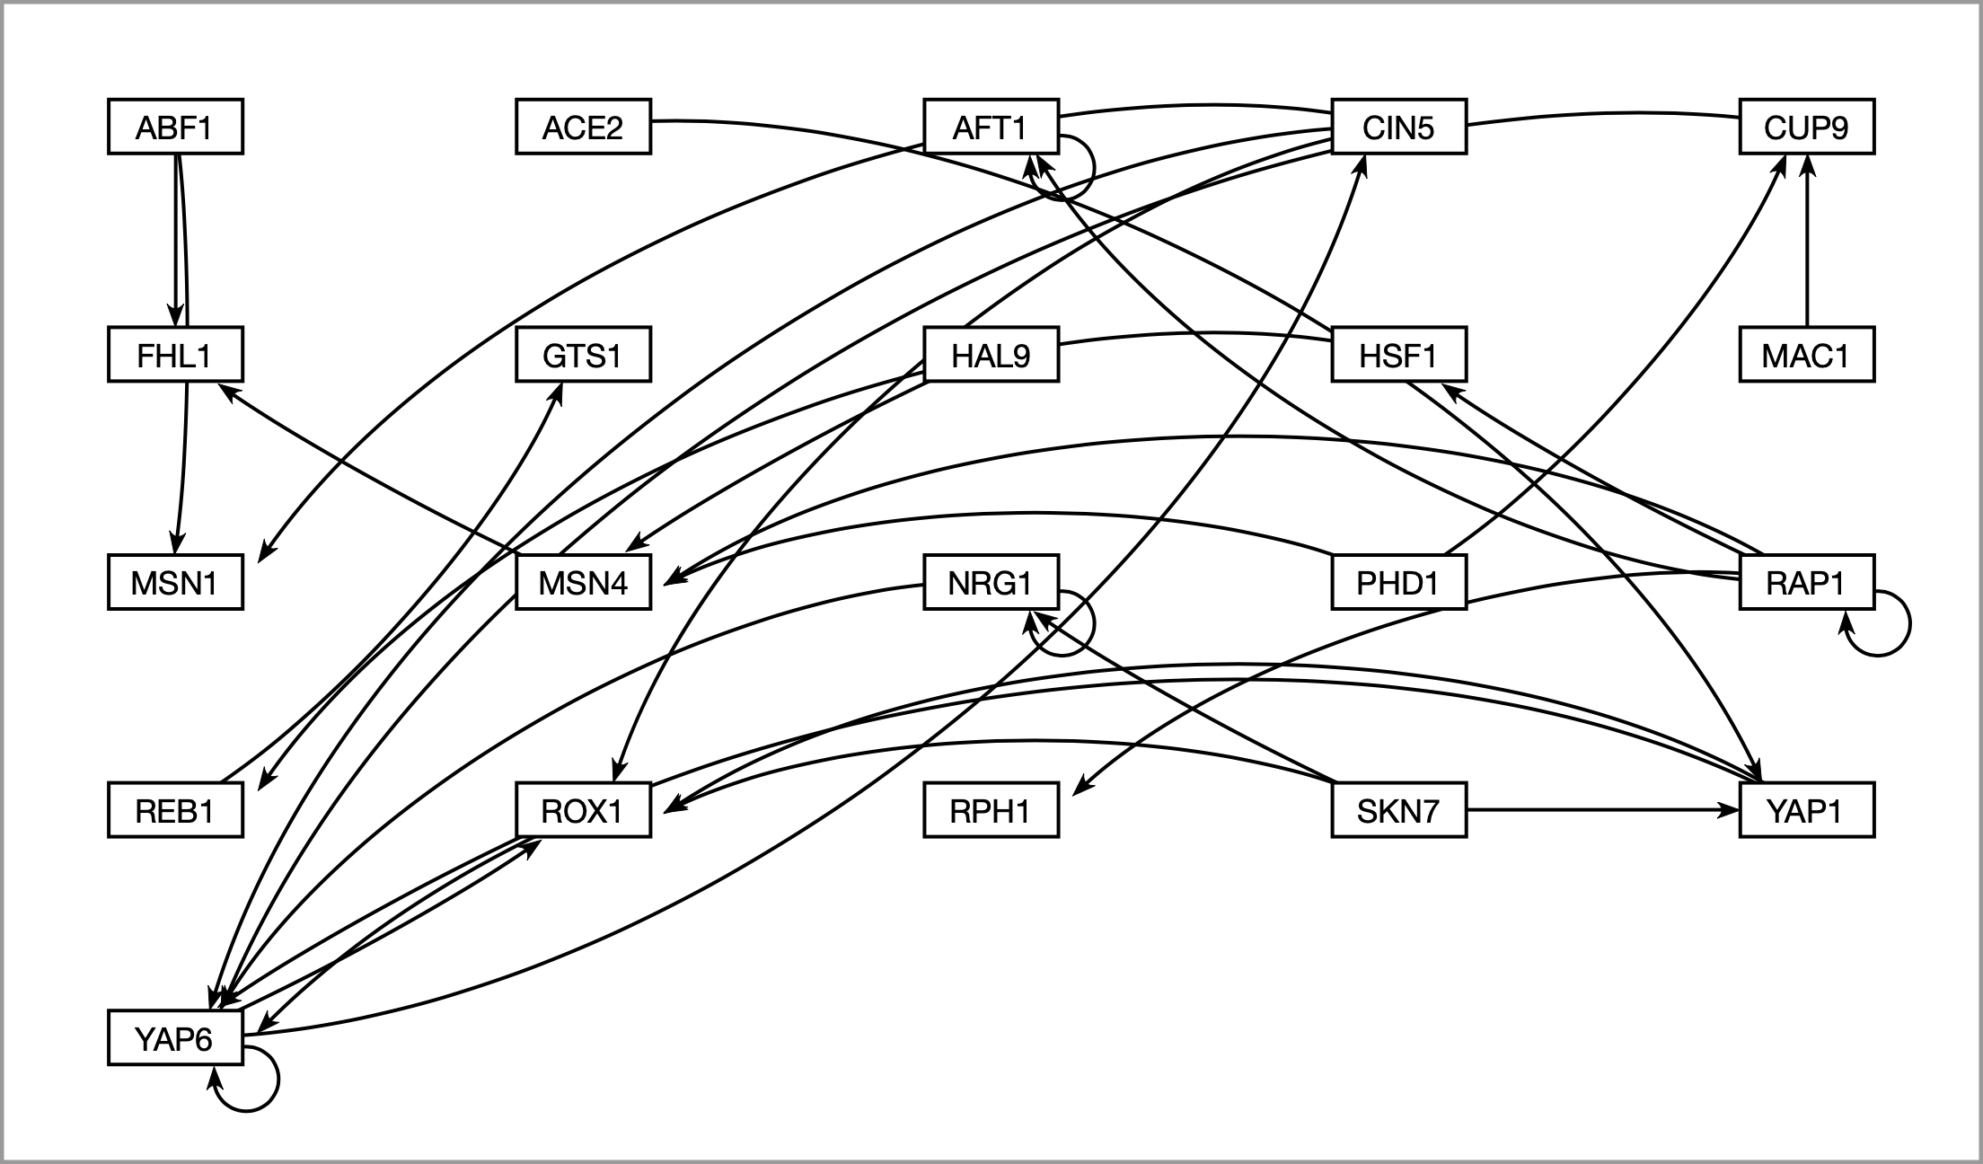
GRNsight now allows users to automatically lay out graphs in an easily readable grid format

Slide 14
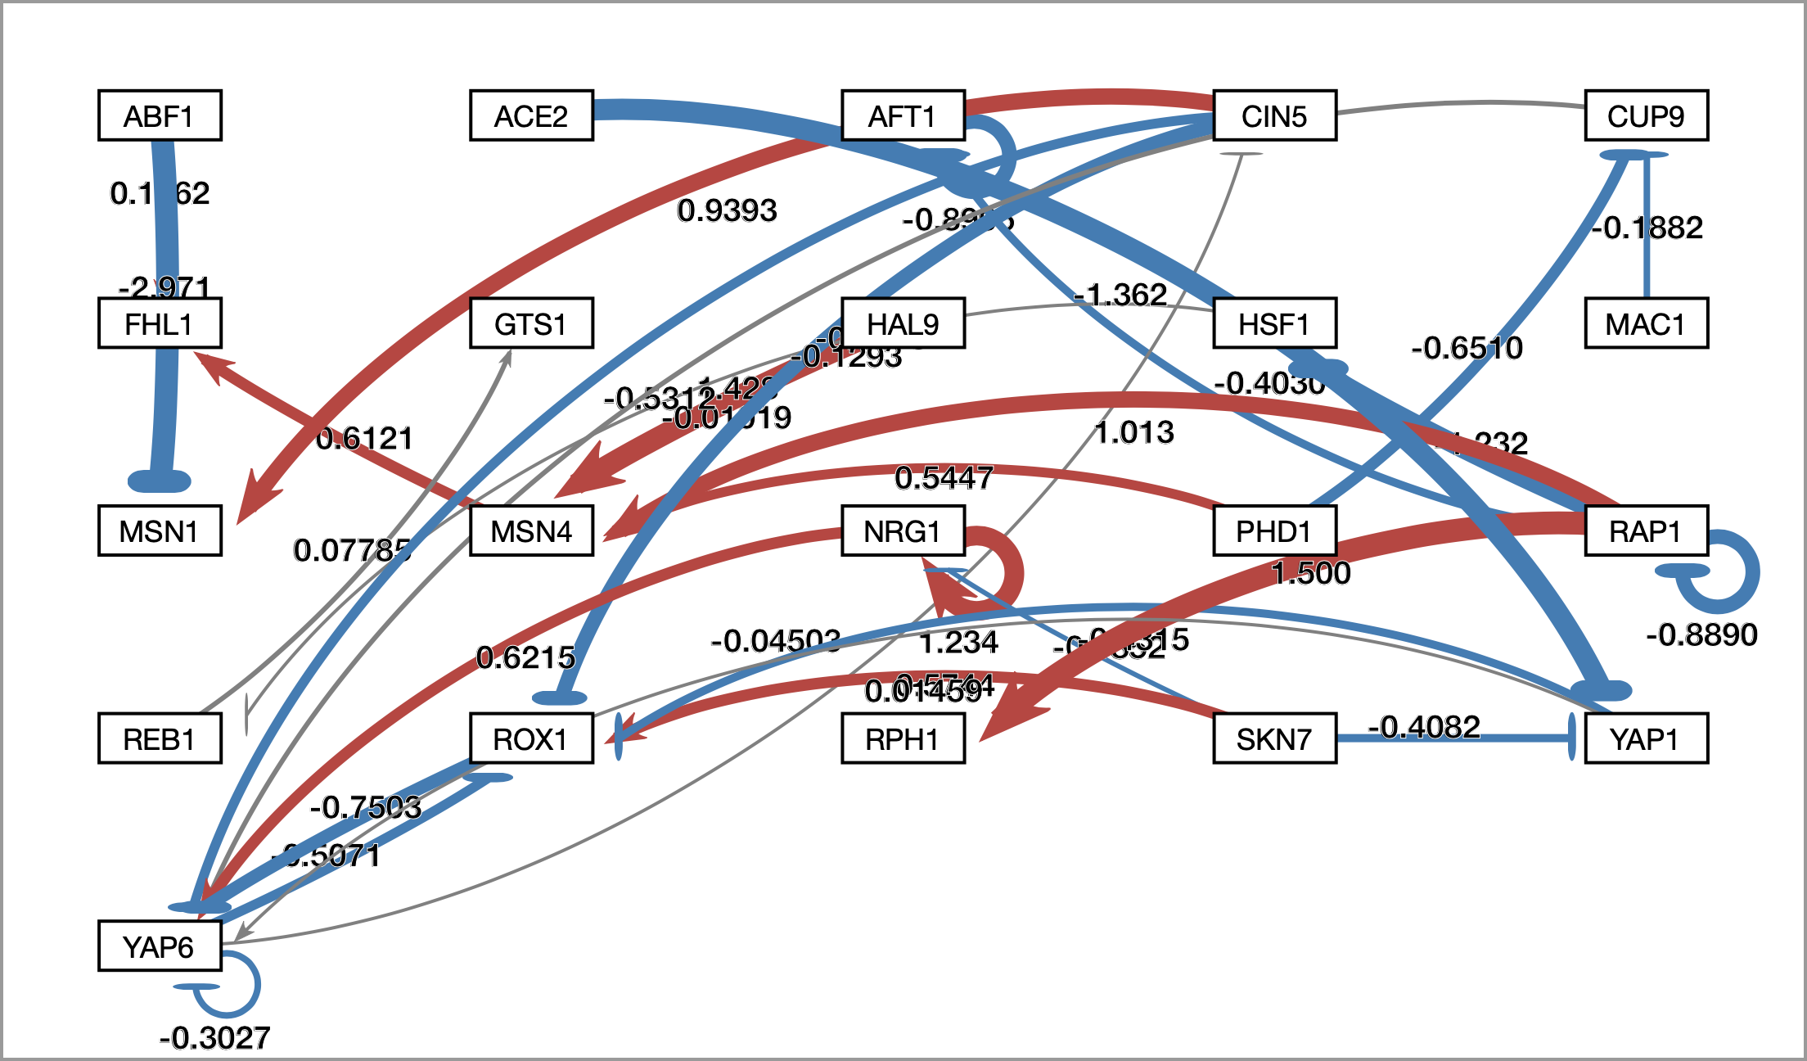
Numerical weight values can be displayed on the graph

Slide 15
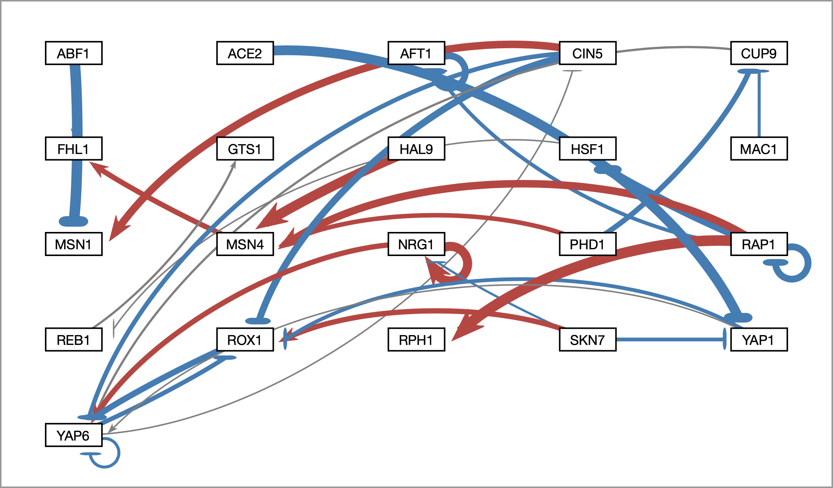
Edge thicknesses are normalized to the largest magnitude weight value
To facilitate better comparison of graphs, users may now modulate normalization factor
Normalization Factor = 1.5

Slide 16
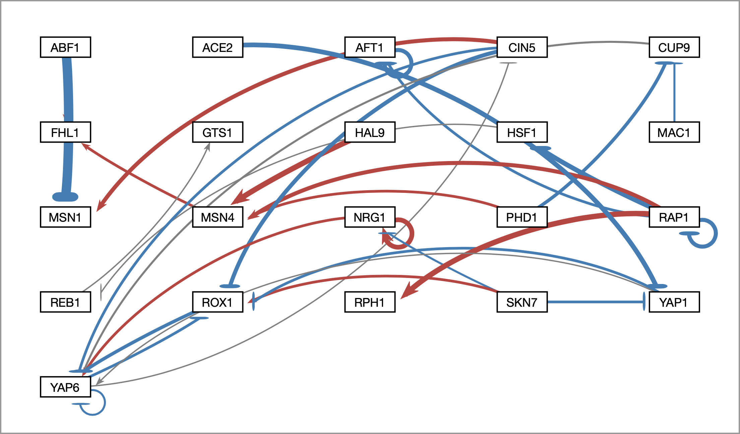
And can be modified to allow fair visual comparison between different graphs
To facilitate better comparison of graphs, users may now modulate normalization factor
Normalization Factor = 3

Slide 17
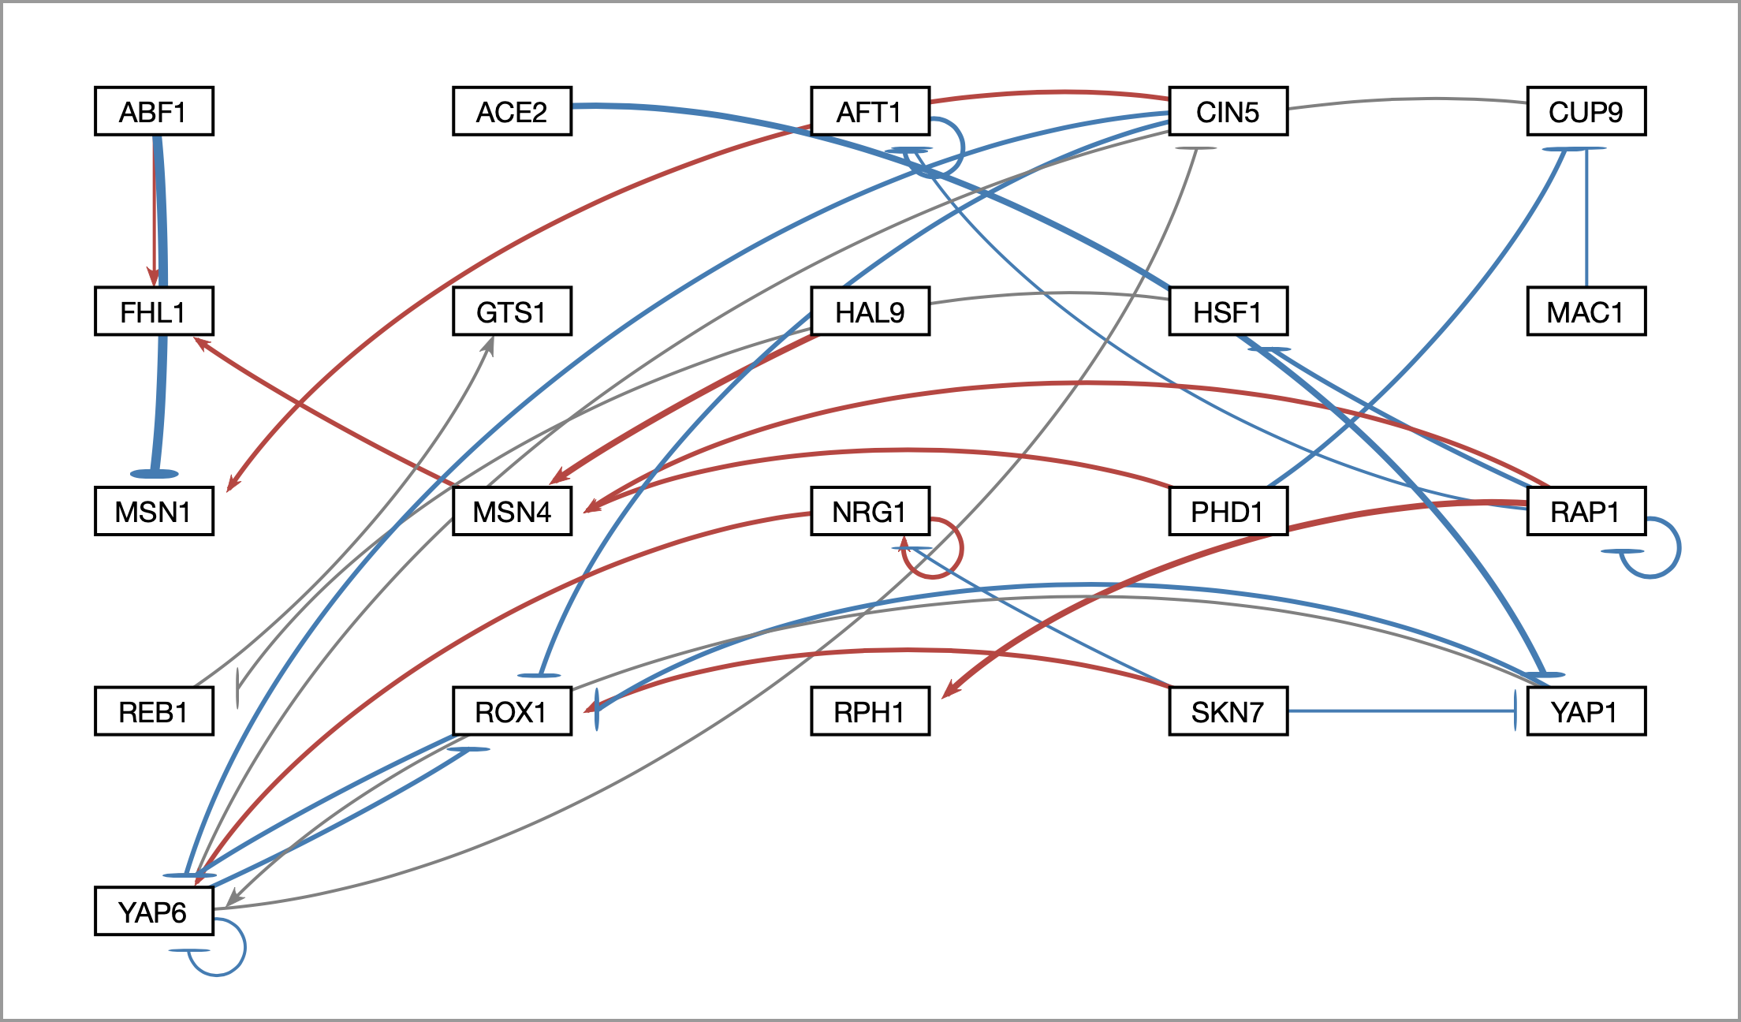
And can be modified to allow fair visual comparison between different graphs
To facilitate better comparison of graphs, users may now modulate normalization factor
Normalization Factor = 10

Slide 18
Edges with normalized weight values within 5% of 0 are displayed as gray to minimize their visual strength
To allow users to direct attention to certain nodes, users may now adjust gray edge threshold
Gray Edge Threshold = 5%

Slide 19
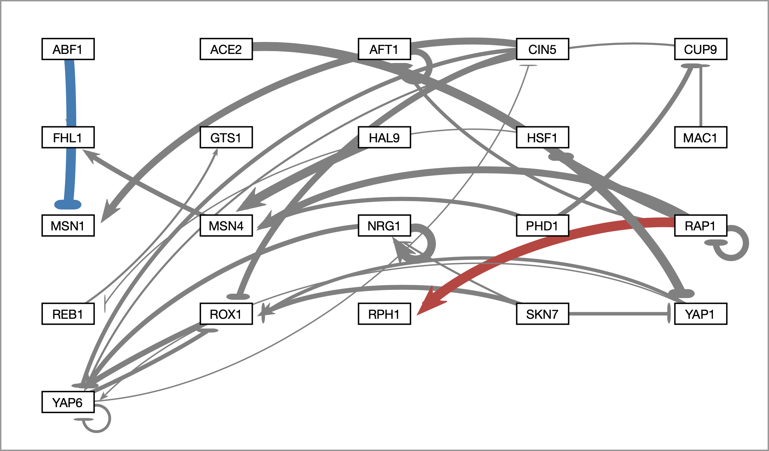
Users can change the gray edge threshold with a slider
To allow users to direct attention to certain nodes, users may now adjust gray edge threshold
Gray Edge Threshold = 50%

Slide 20
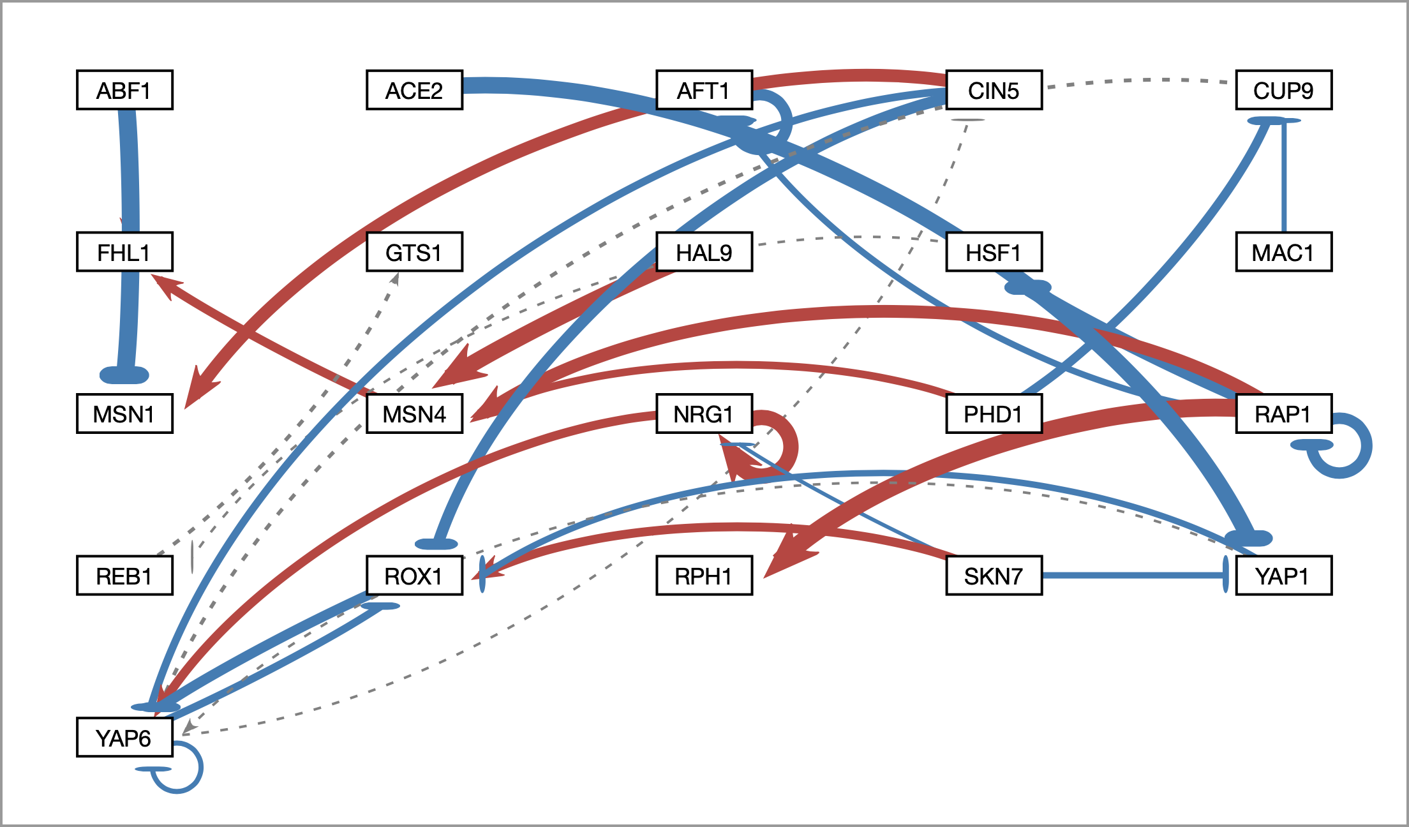
Gray edges can also be shown as dashed lines to facilitate visualization by color blind users
As a benefit to visually impaired users, gray edges may be displayed as dashed lines
Gray Edge Threshold = 5%

Slide 21
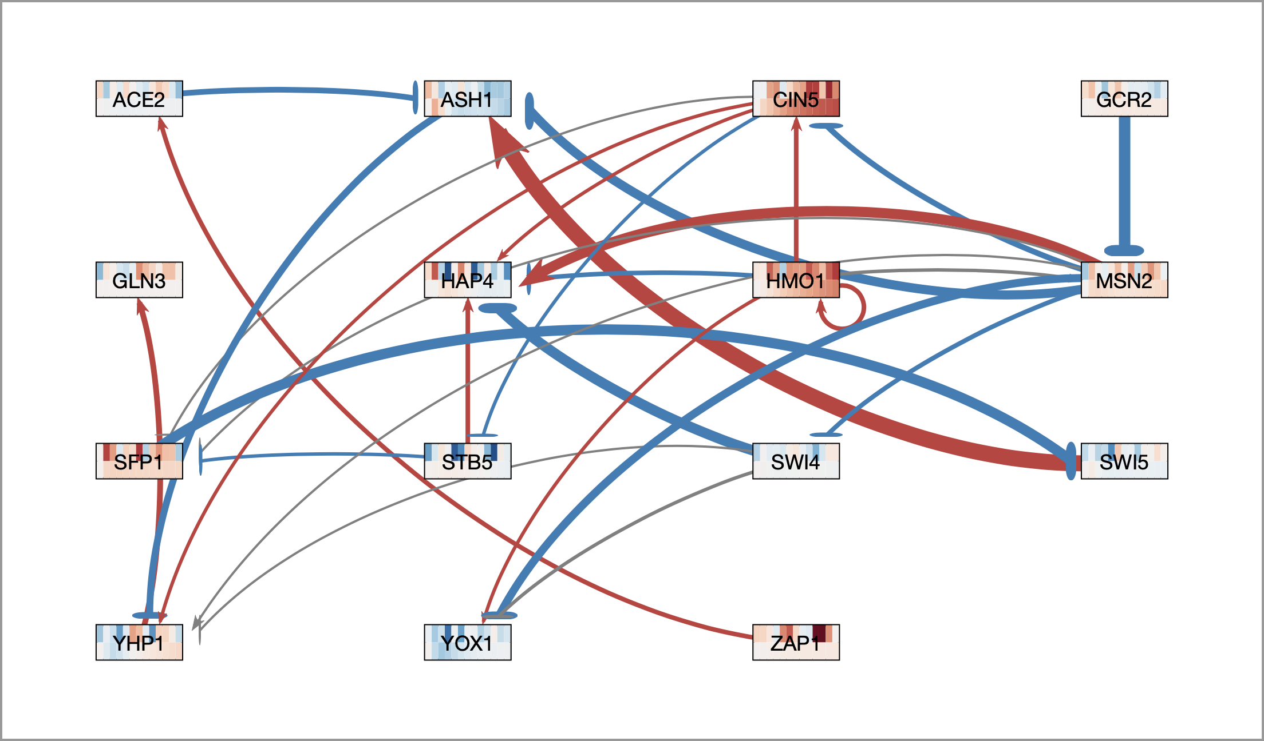
Nodes now display measured and/or simulated expression data as individual heat maps
Top = wild type microarray data
Bottom = Δ gln3 microarray data

Slide 22
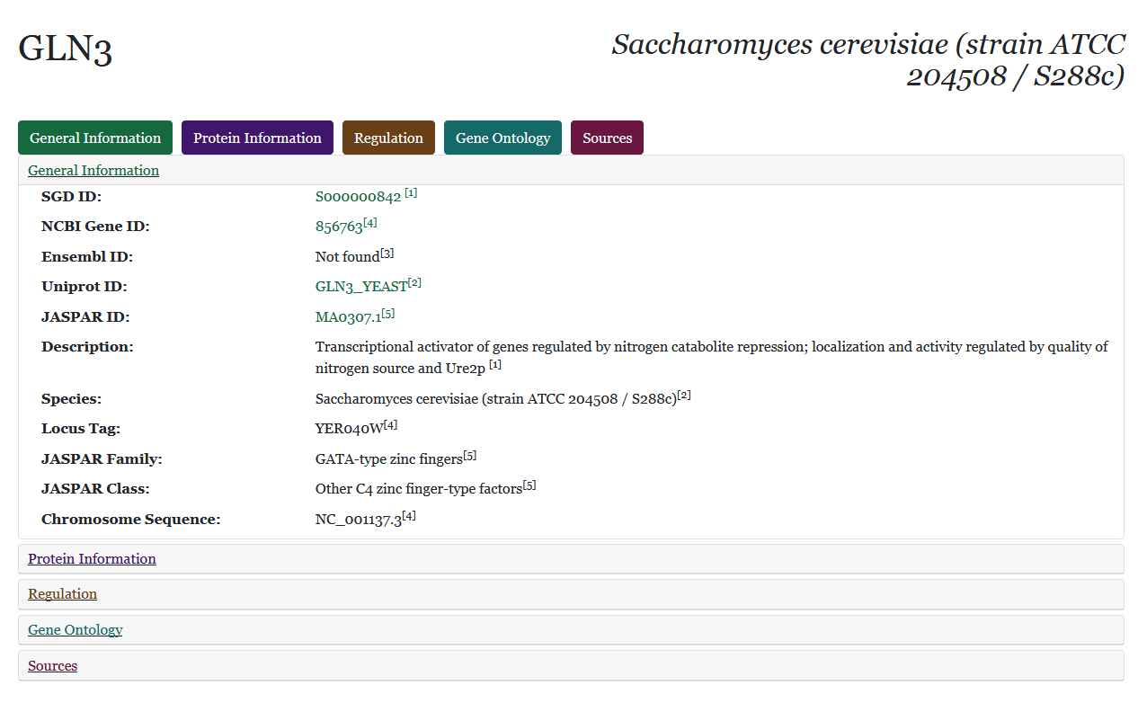
Right-clicking on a node opens a web page which displays information retrieved from various databases

Slide 23
However…
In the past 5 years:
GRNsight’s codebase has expanded nearly 10x
13 new features have been added
Lead to application instability, user interaction bugs

Slide 24
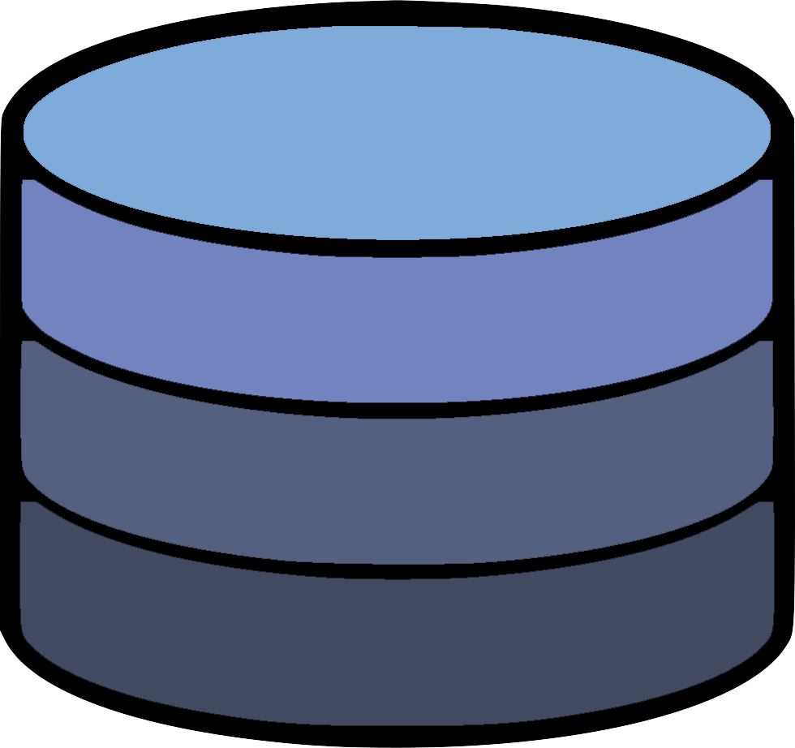
The Model-View-Controller paradigm is an architectural pattern used for developing user interfaces
Model
Updates
Manipulates
View
Controller
Sees
Uses
User

Slide 25
The Model-View-Controller paradigm is an architectural pattern used for developing user interfaces
Creates separation of internal representations of information from the ways information is presented to and accepted from the user
Decouples the various components that comprise a complex application like GRNsight
Model
Updates
Manipulates
View
Controller
Sees
Uses
User

Slide 26
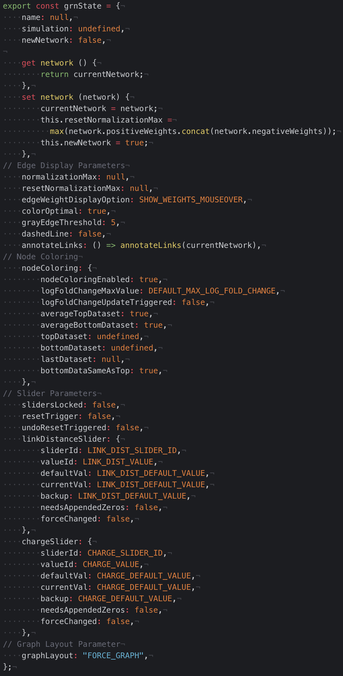
Why the MVC architecture?
Central store for application state & increased modularity:
Lessening application state conflicts
Diagnosing a bug
Adding a new feature

Slide 27
GRNsight’s new central architectural pattern
grnstate.js
Model
Updates
Manipulates
update-app.js
View
Controller
setup-handlers.js
Sees
Uses
User
12 files → 7 files

Slide 28
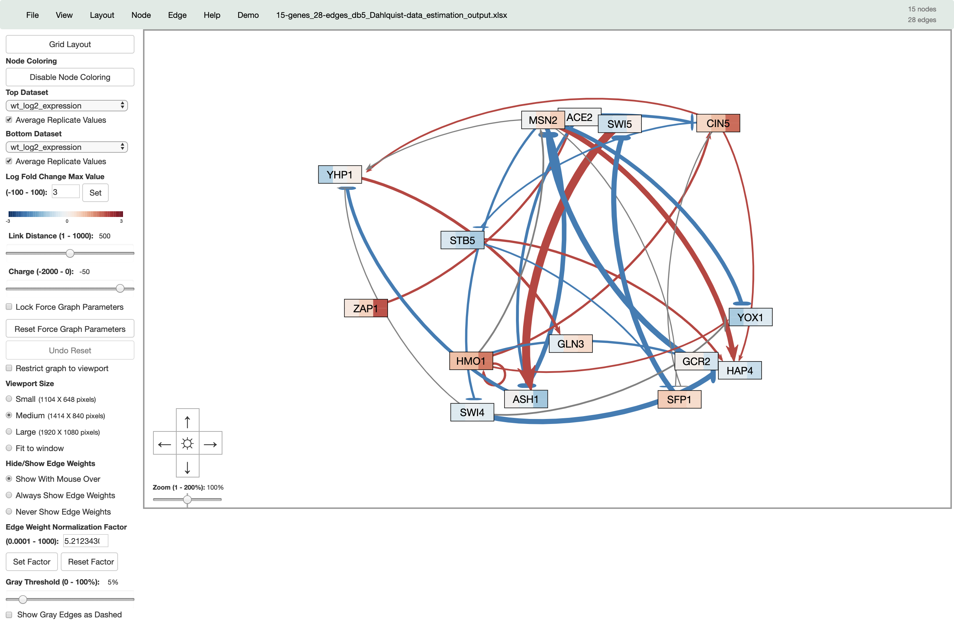
90% of the GRNsight codebase now follows a strict MVC architecture
User-inputted parameters
(completely refactored to MVC)
Graph physics controlled by d3.js
(refactor upcoming)

Slide 29
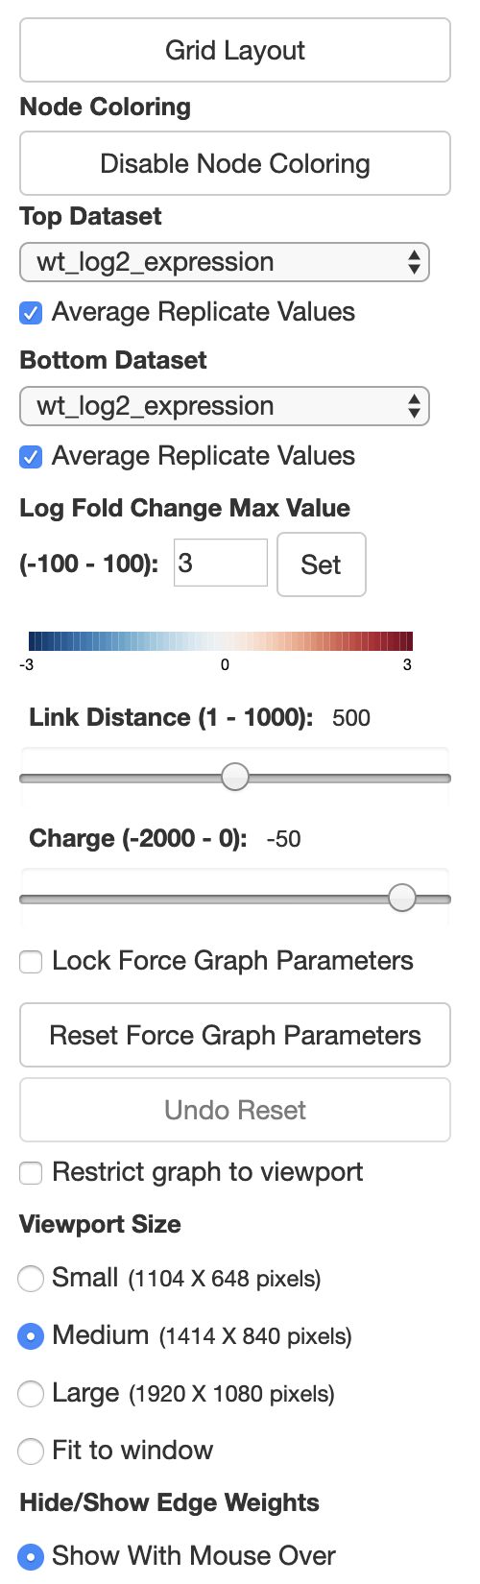
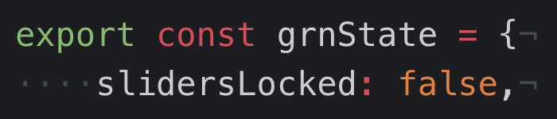
The MVC refactor is “under the hood,” and is seamless to the user
Locking Force Graph Parameter Sliders
Model
Updates
Manipulates
View
Controller
Sees
Uses
User

Slide 30
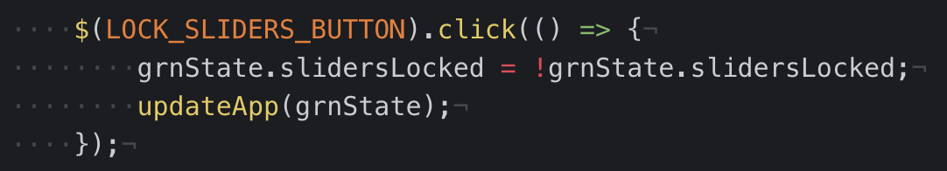
The MVC refactor is “under the hood,” and is seamless to the user
Locking Force Graph Parameter Sliders
Model
Updates
Manipulates
View
Controller
Sees
Uses
User

Slide 31
The MVC refactor is “under the hood,” and is seamless to the user
Locking Force Graph Parameter Sliders
Model
Updates
Manipulates
View
Controller
Sees
Uses
User

Slide 32
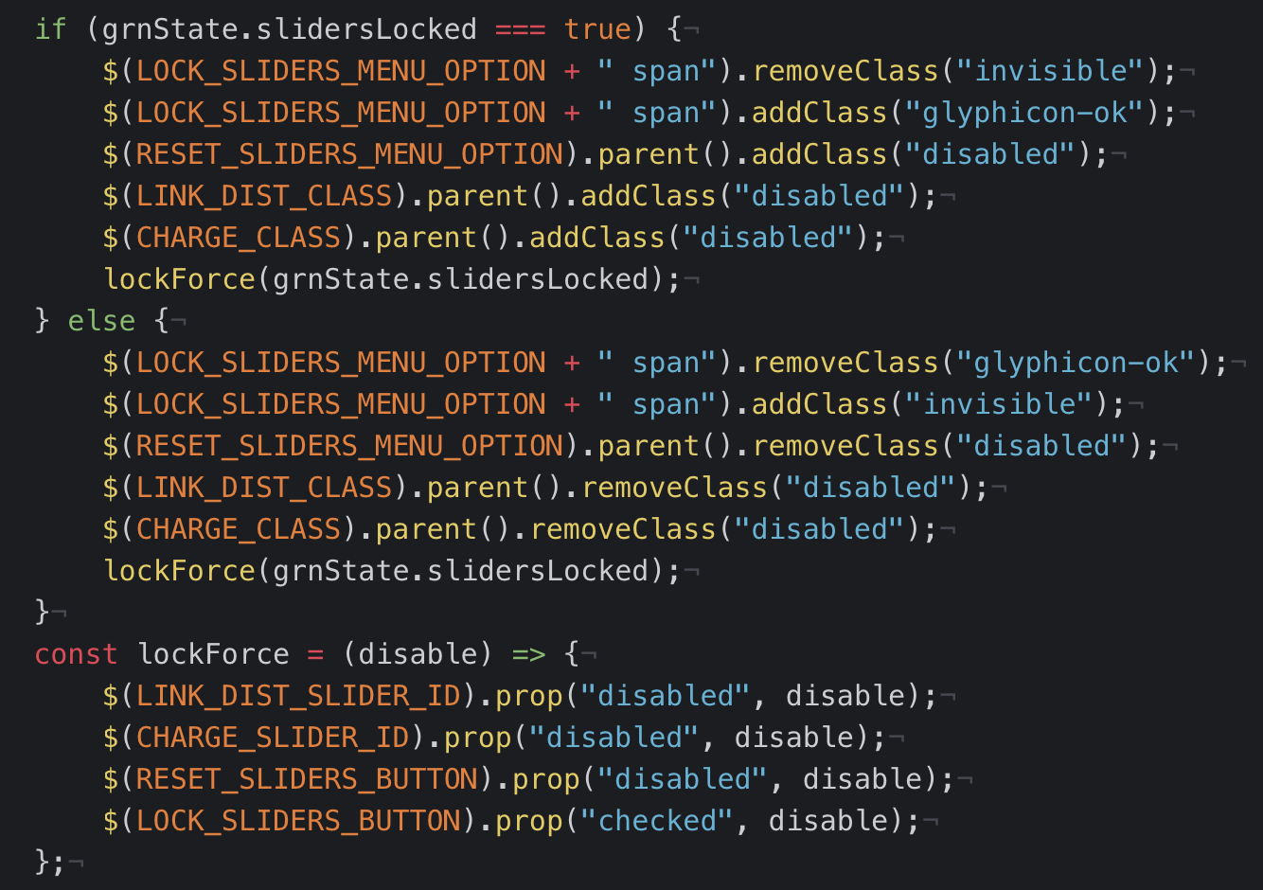
The MVC refactor is “under the hood,” and is seamless to the user
Locking Force Graph Parameter Sliders
Model
Updates
Manipulates
View
Controller
Sees
Uses
User

Slide 33
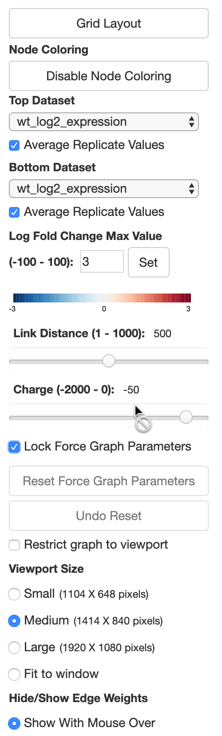
The MVC refactor is “under the hood,” and is seamless to the user
Locking Force Graph Parameter Sliders
Model
Updates
Manipulates
View
Controller
Sees
Uses
User

Slide 34
Conclusion
Gene regulatory networks (GRNs) consist of genes, transcription factors, and the regulatory relationships between them.
GRNsight is an open source web application and service for visualizing models of gene regulatory networks.
GRNsight has matured since version 1.0, adding new features such as new layout options and data types.
This has necessitated a complete refactor of GRNsight code to the Model-View-Controller paradigm, which facilitates easier user and developer interactions with the application.

Slide 35
GRNsight application and code are available under the open source BSD license
http://dondi.github.io/GRNsight/
https://github.com/dondi/GRNsight
Current and future work documented via Github Issues
Graph.js as an object
ReactJS
Import networks from gene databases
Automate the creation of GRNmap workbooks

Slide 36

Acknowledgements
GRNsight Team
Alexia Filler
John Lopez
Justin Kyle Torres
GRNmap Team
Lauren Kelly
Wet Lab Team
Genesis Cruz
Dr. Kam D. Dahlquist
Dr. John David N. Dionisio

